Slide 1
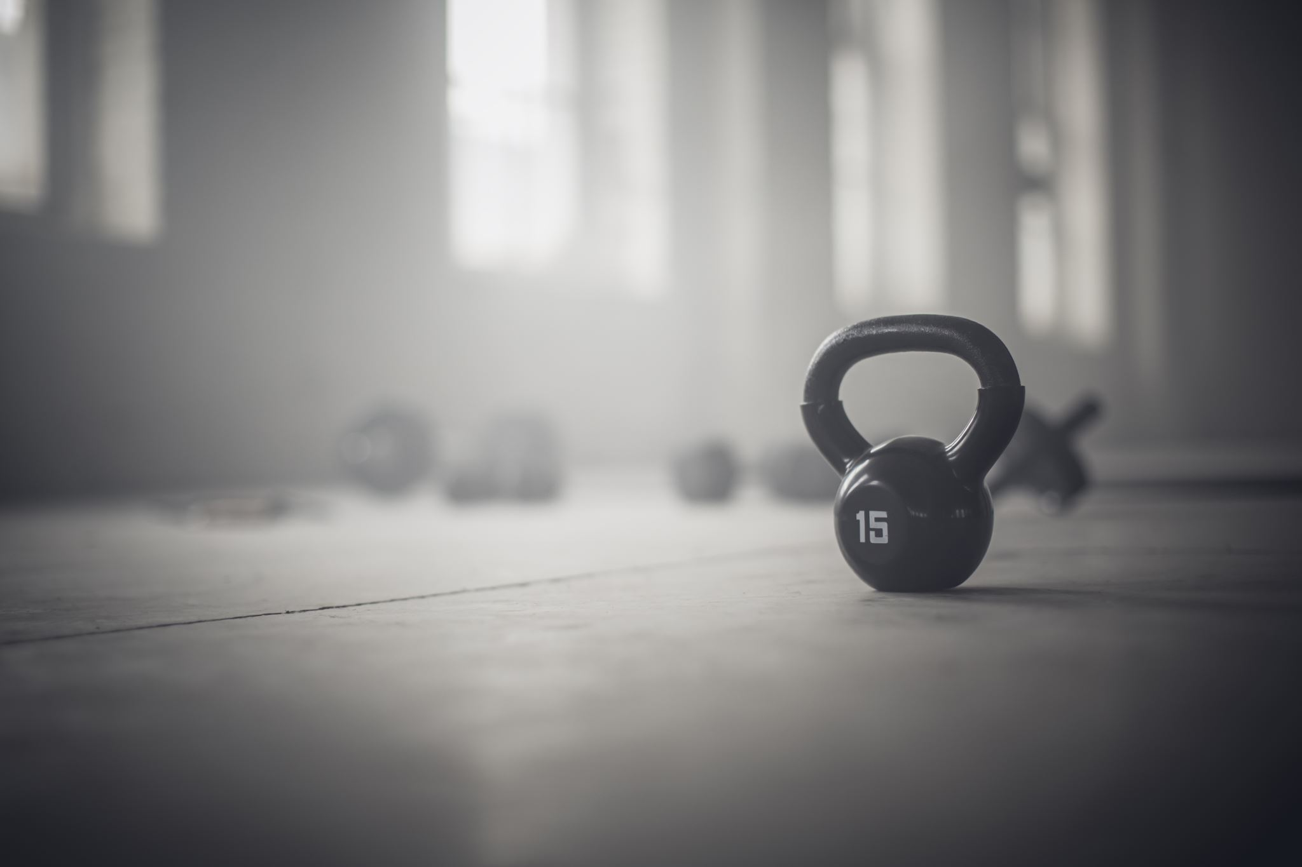
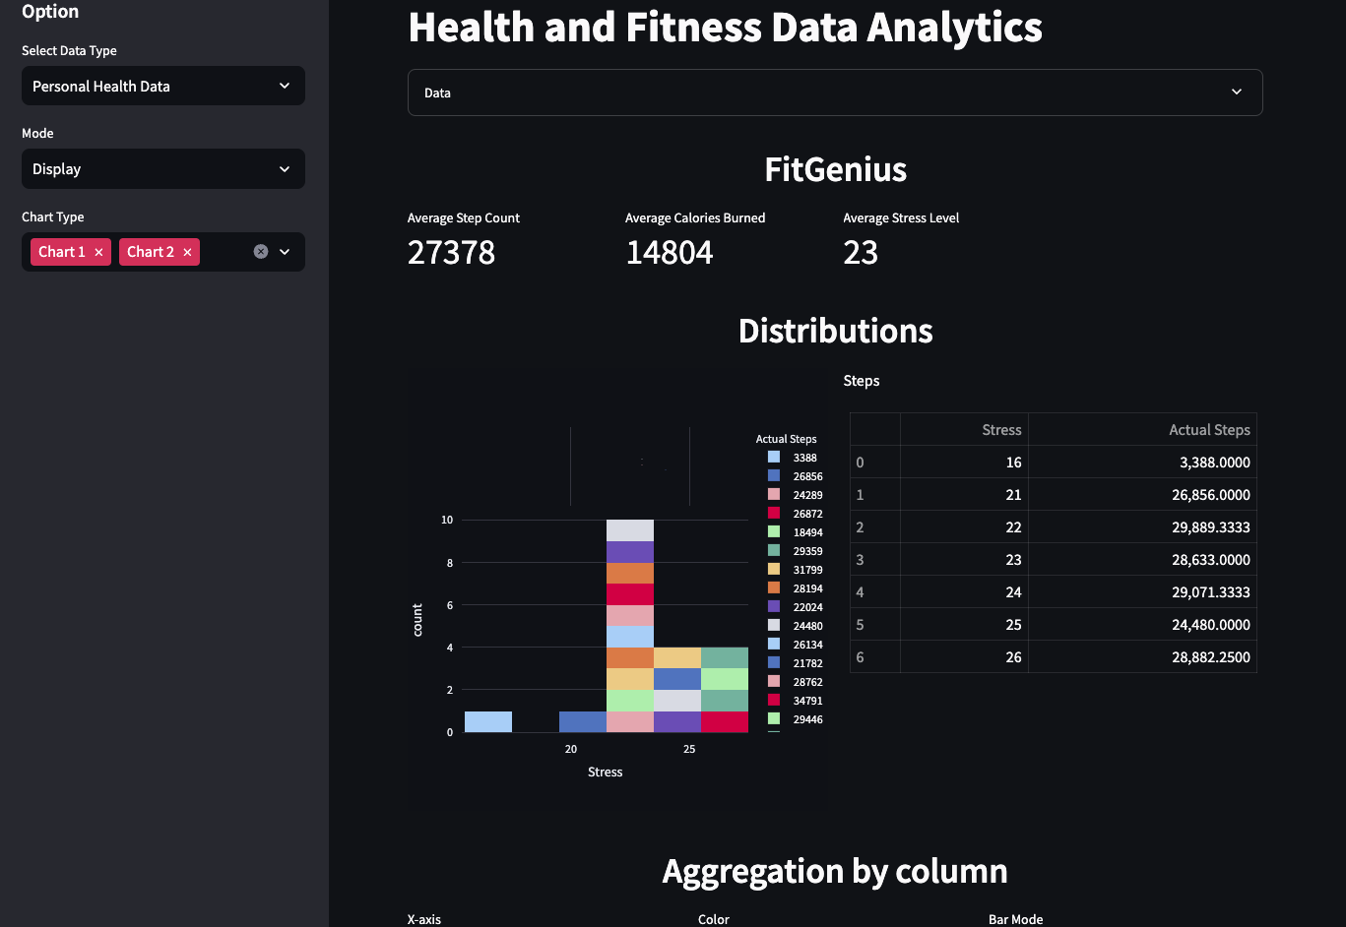
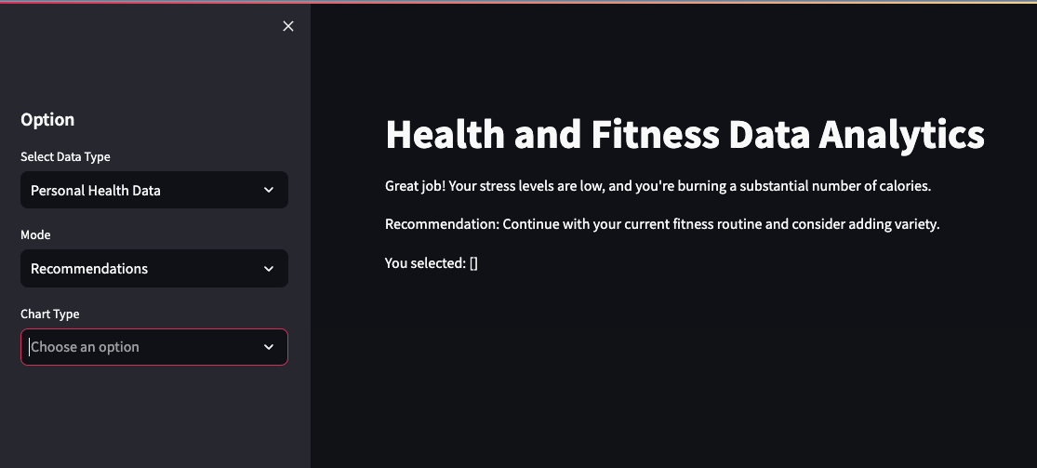
Fit Genius
💪🏾 Nathaniel Blackmon
💪🏿 André Derilus
💪🏾 Mariah Hubbard
💪🏿 Kameron Jackson
Transforming health metrics from your smart device into an actionable fitness plan
What you get:
- Simplicity and precision
- Dashboard with real-time visualizations
- Personalized fitness recommendations

